Slide 1
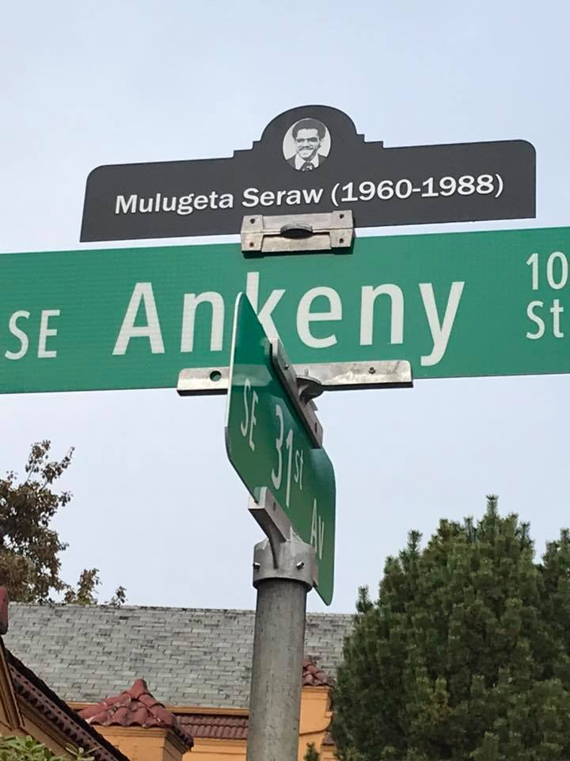
Hate Speech & Free Speech:
Where do they meet?
Randy Blazak
Coalition Against Hate Crimes

Slide 2
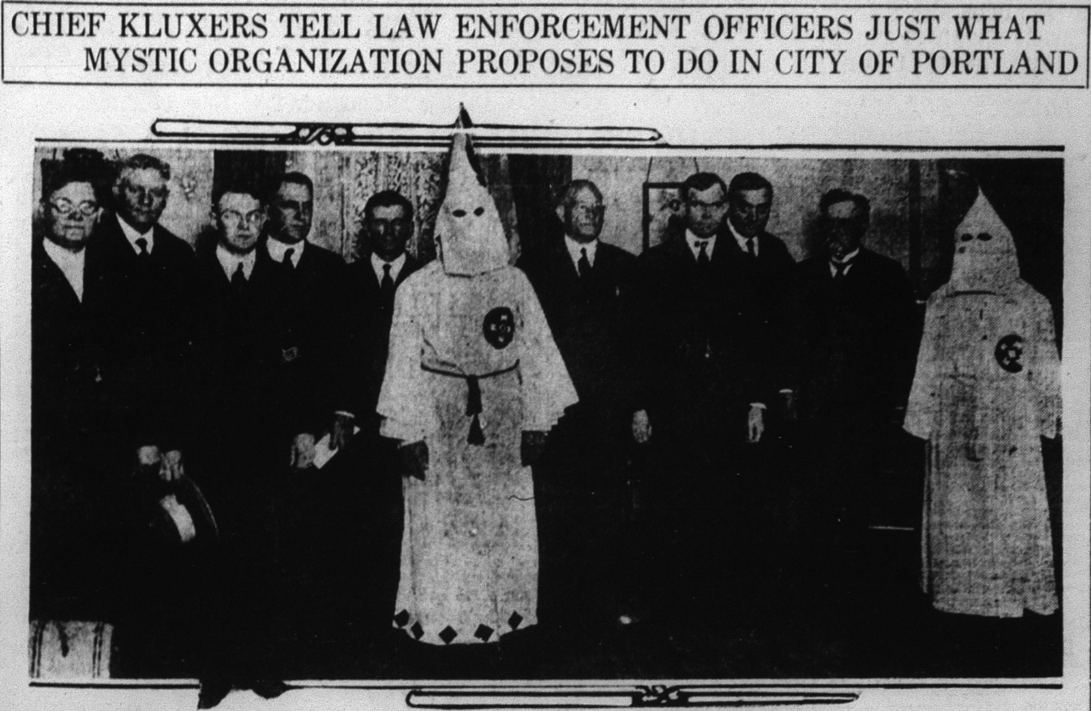
Oregon’s Racist History
= trauma
Oregon Land Donation Act
Exclusion Laws
Oregon as the only “whites only” state
The dominance of the KKK in the 1920s
Institutional racism in housing and development
Racist skinheads in the 1980s & 1990s
The Alt Right

Slide 3
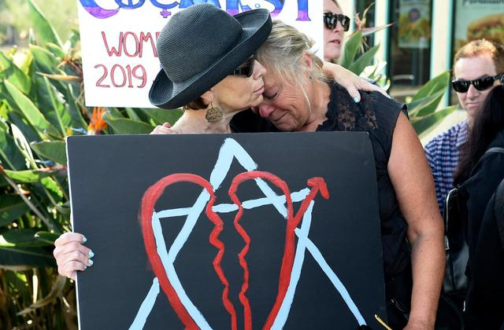
The Current Climate

Slide 4
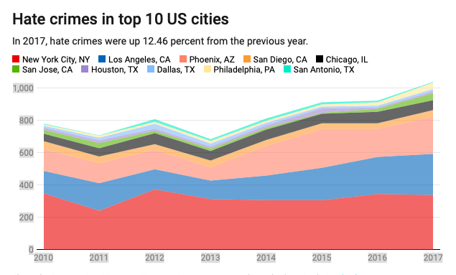
The Current Climate

Slide 5
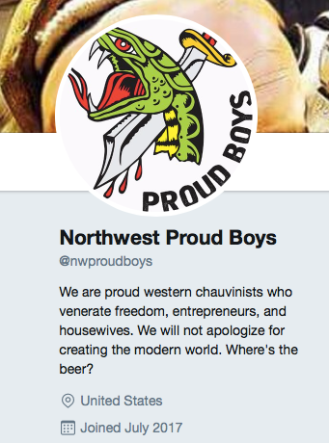
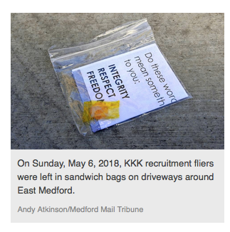
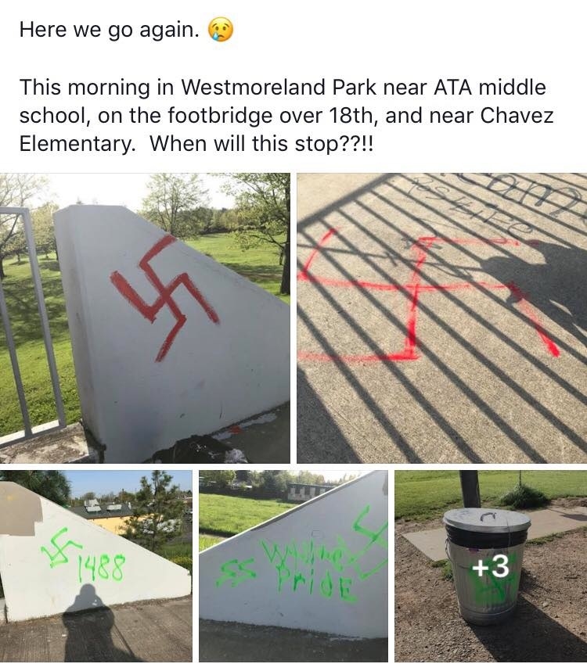
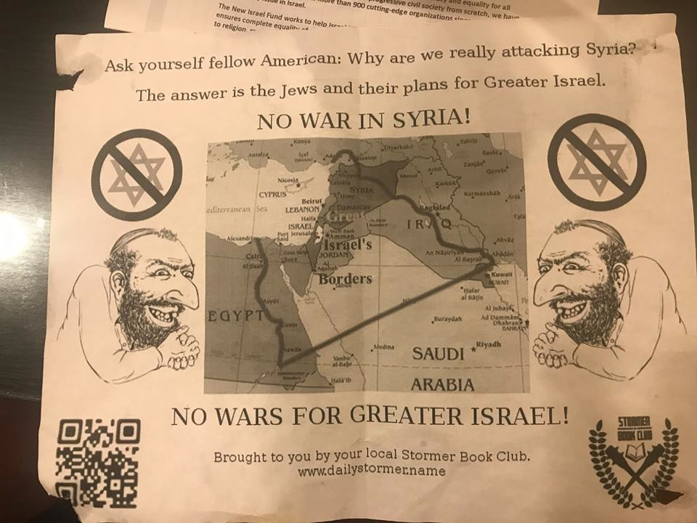
The current Climate

Slide 6
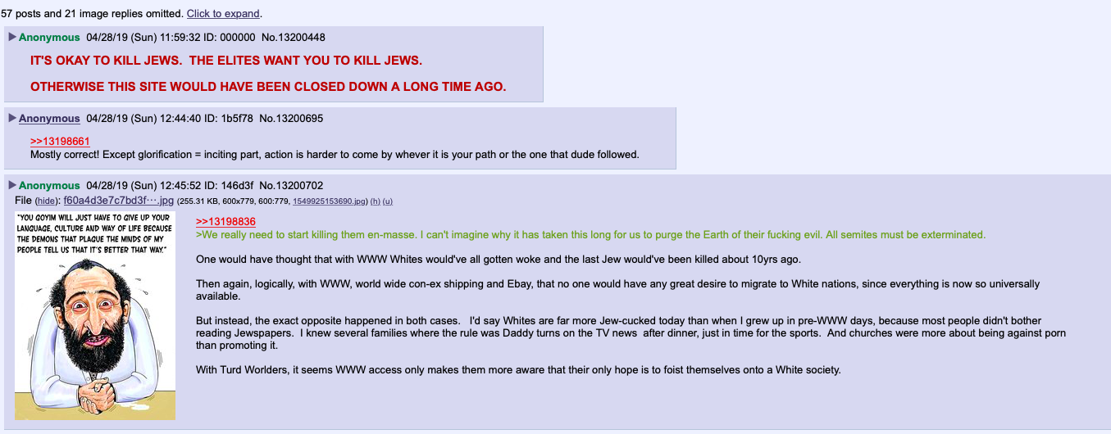
The Current Climate

Slide 7
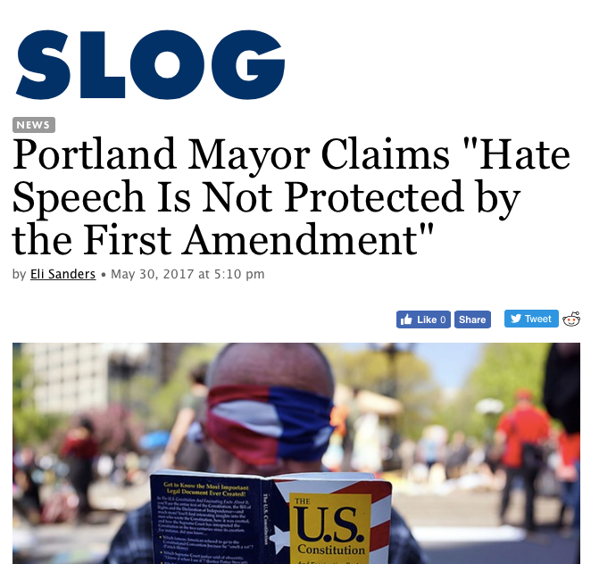
IS HATE SPEECH FREE SPEECH?

Slide 8
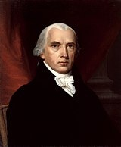
The First Amendment
Congress shall not make any laws:
establishing or prohibiting religion
the freedom of speech
the freedom of the press
the right to peaceably assemble
the right to petition the government
Adopted Dec. 15, 1791

Slide 9
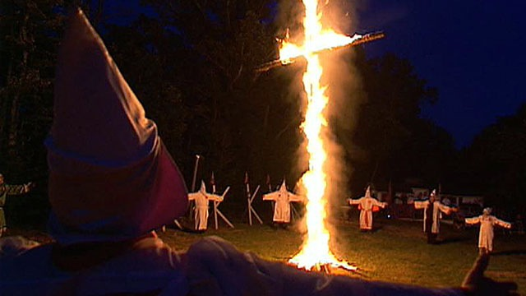
It’s not always easy to know if something is “free speech”
Virginia v. Black (2003)

Slide 10
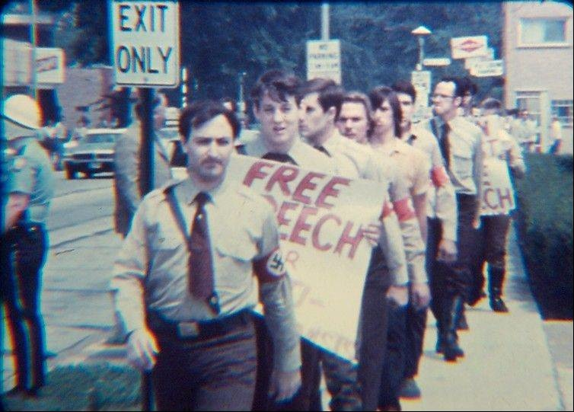
Example: Skokie, IL. 1977

Slide 11
When Hate Speech becomes hate Crime
If a person intentionally subjects another to offensive physical contact because of the person’s perception of the other’s race, color, religion, sexual orientation, disability or national origin.
“Credible threat of violence”

Slide 12
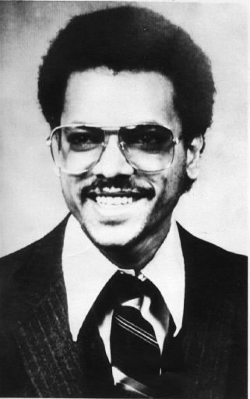
The murder of mulugeta seraW
Portland, November 12,1988
Racist skinheads - East Side White Pride
Lawsuit for wrongful death
What if Tom Metzger had a lawyer?

Slide 13
Oregon “Bias Crime” Statute
SB 577 includes violent crime, property crime, and threats
Based on offenders perception of victim’s race, color, religion, sexual orientation, gender identity, disability or national origin.
Based on the perception of the victim, but need motive to charge
Penalty enhancement

Slide 14
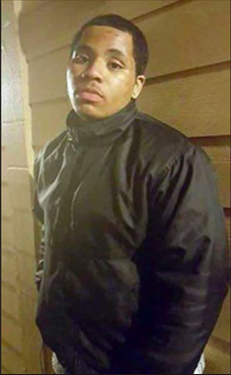
The Murder of Larnell Bruce, Jr.
Gresham, August 13, 2016
Murdered by a member of European Kindred
Jury determined the act was motivated by racial hatred, May 19, 2019
Life in prison

Slide 15
Federal Civil Rights Laws
Matthew Shepard/James Byrd Jr. Act (2009) covers violent crimes committed because of the actual or perceived race, color, religion, national origin, gender, sexual orientation, gender identity, or disability of the victim.
Religious desecrations.
Interstate threats (18 U.S. Code 875 c)

Slide 16
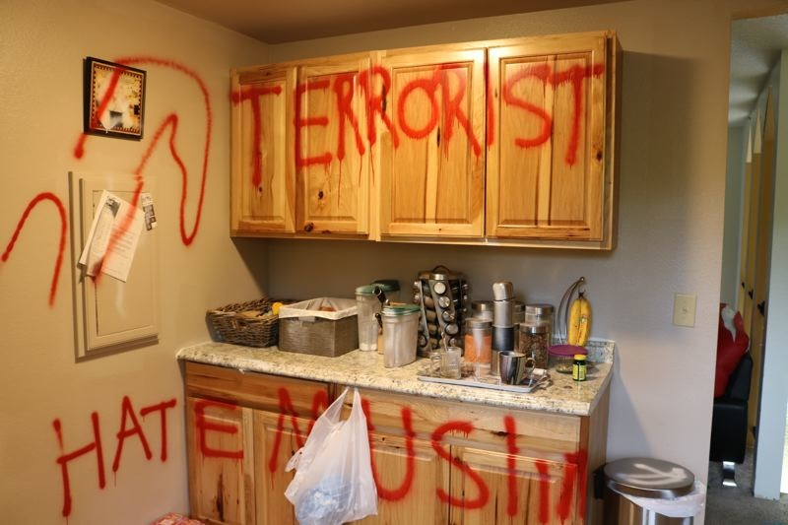
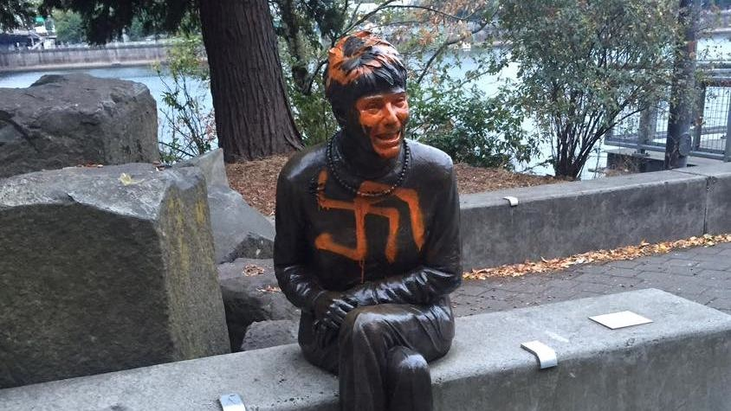
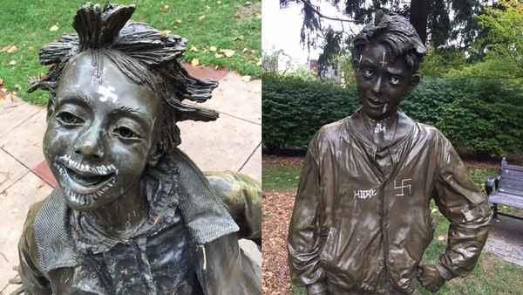
GraffiTI

Slide 17
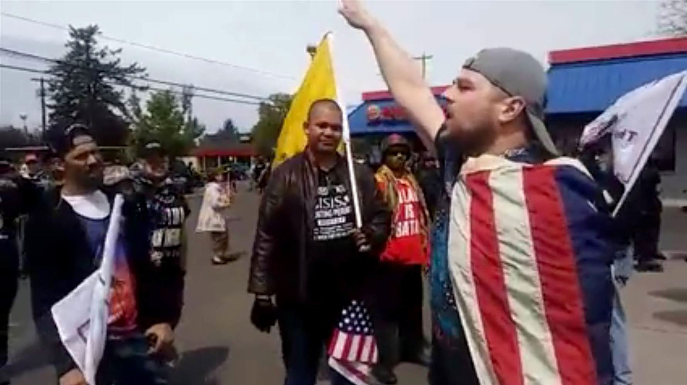
Threatening Speech

Slide 18
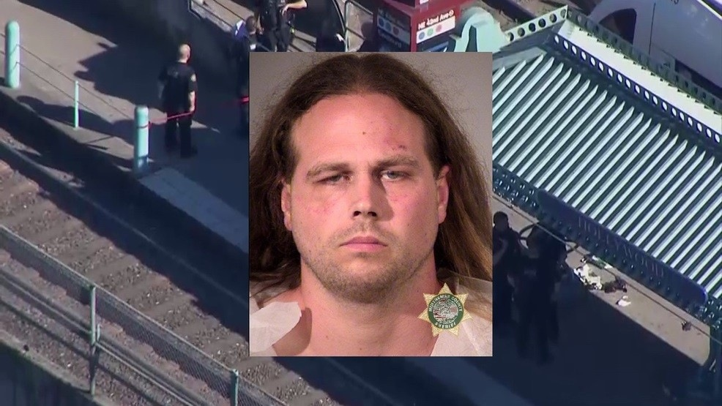
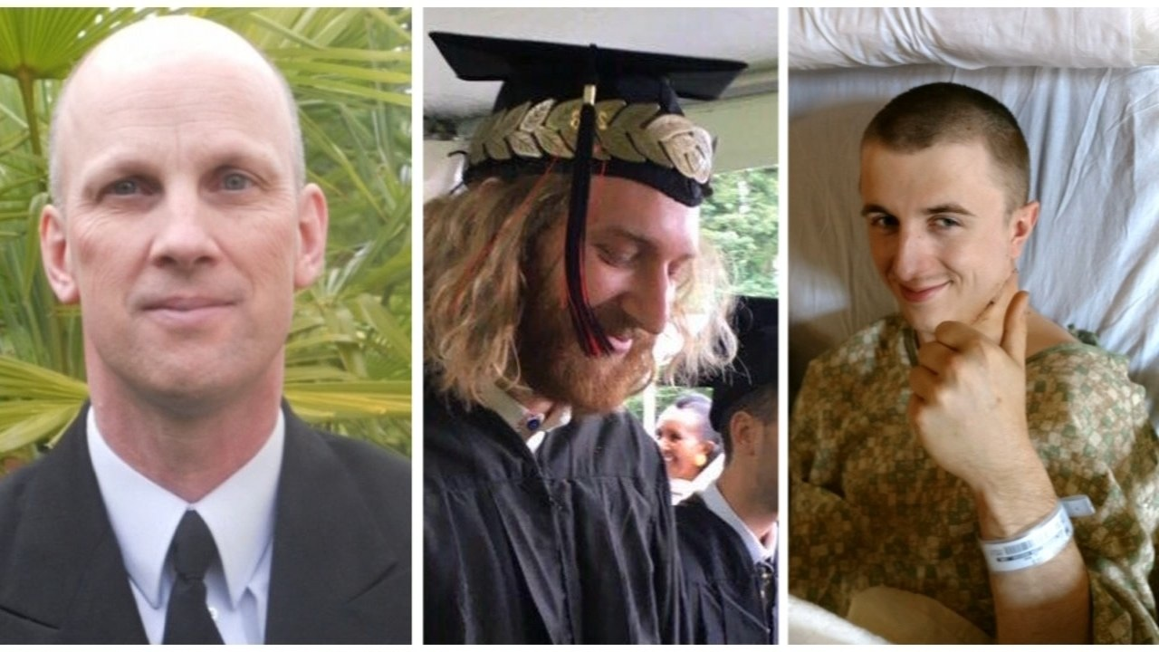
May 26, 2017 Max Murders
Harassment of two teenage girls
Anti-immigrant, anti-Muslim speech
Three (white) men who tried to stop him were stabbed.
Collective trauma (again)

Slide 19
Is hate speech at school OK if it is free speech?

Slide 20
nope
Emotional trauma
Encouraging crime
Creates divisions
Waves of impact
Do all students feel safe?

Slide 21
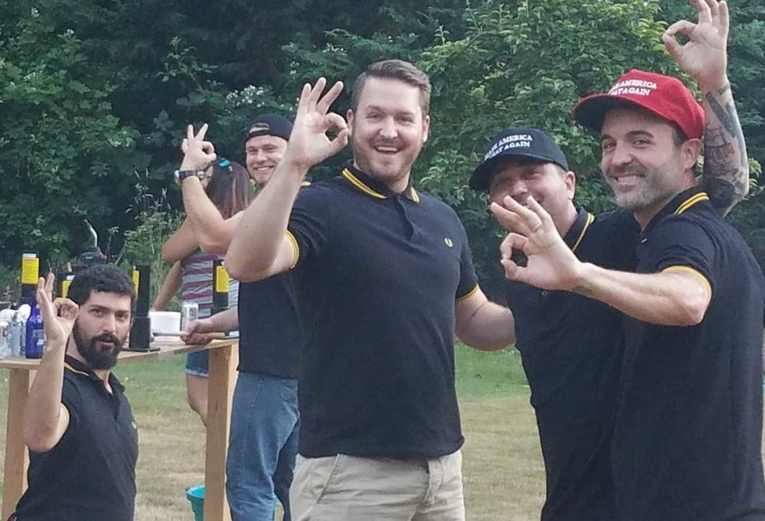
Thinking about
the alt-right
Similarities to hate groups
Conspiracy theories
Targeting young white males for recruitment, especially on social media
Utilization of free speech “grey areas”

Slide 22
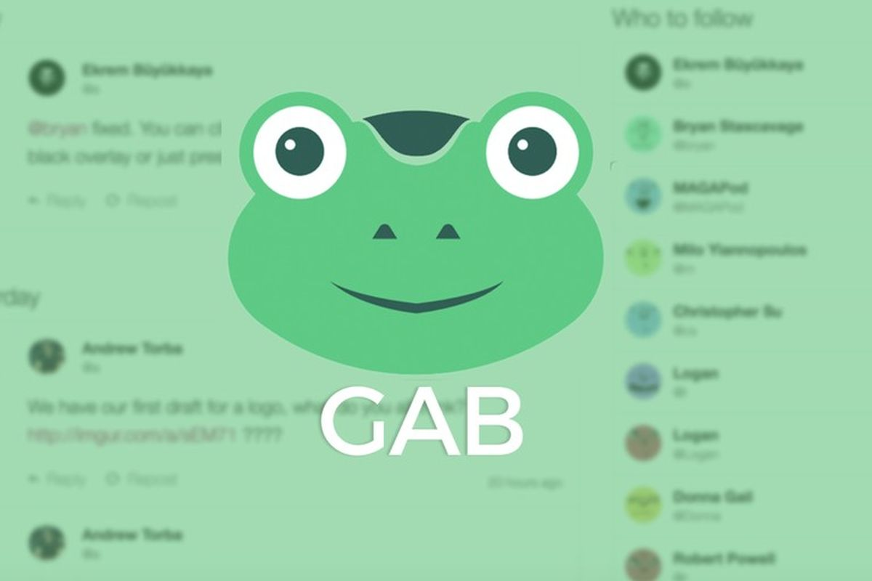
Tactics Used on Gen Z
“White genocide” narrative
Binary thinking
Hyper-masculine “battle”
“Defending” America
Anomie

Slide 23
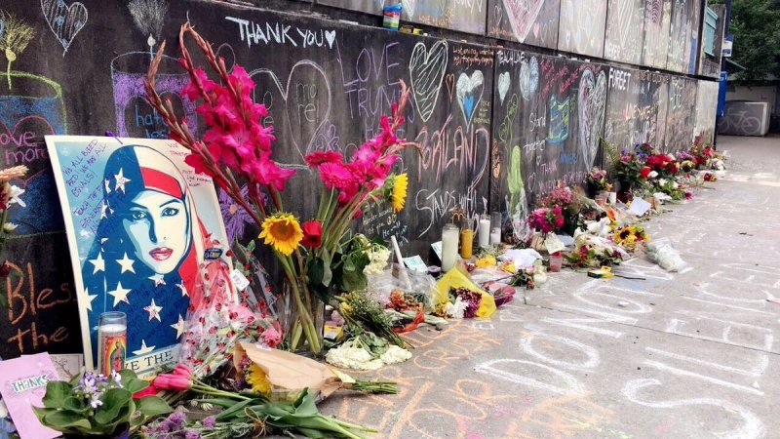
How to stop hate
Listen to stories from people who are different from you.
Learn about the history of diversity and resistance.
Build empathy.
Make standing against hate and creating safe spaces the righteous position.

Slide 24
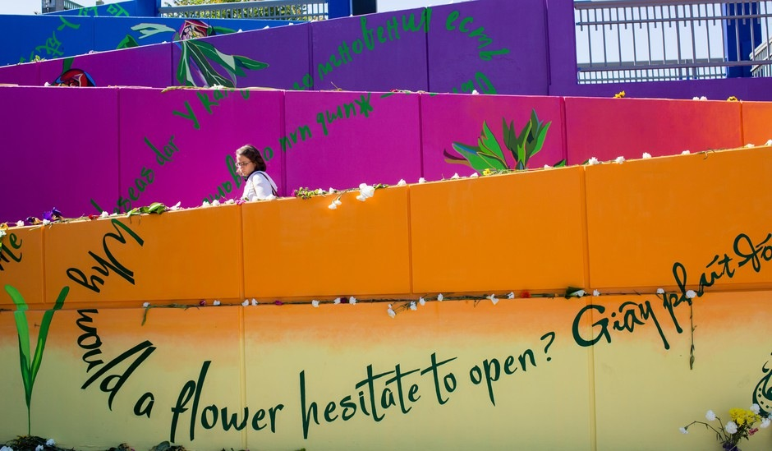
Increase the Peace!

